Slide 1


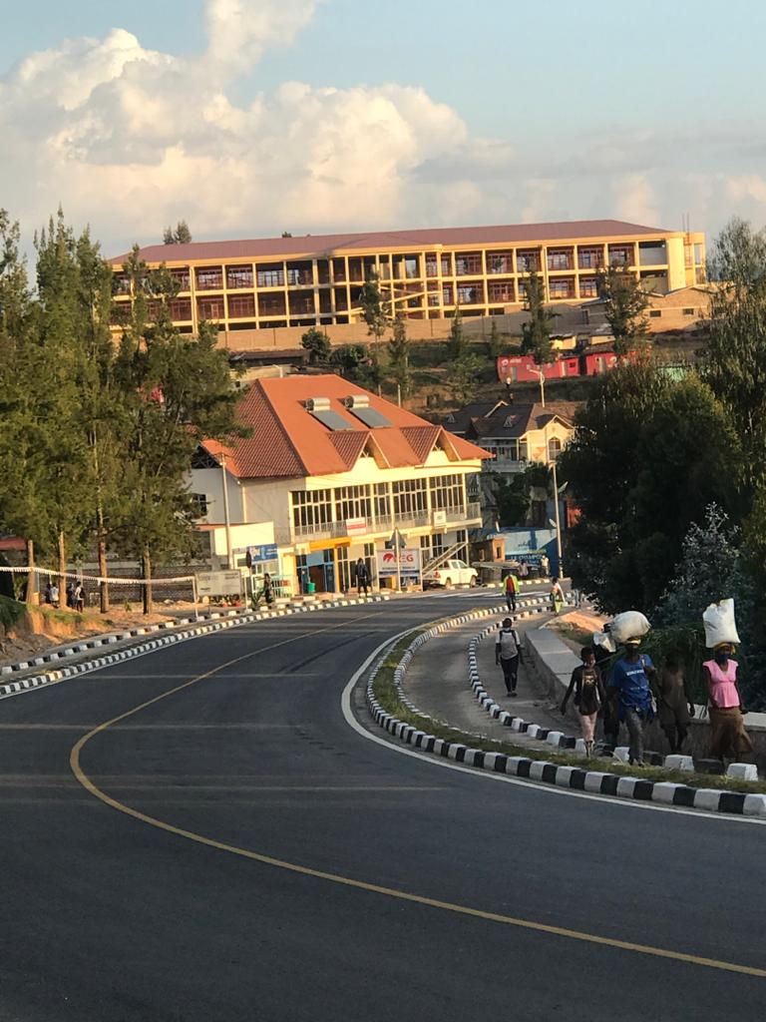
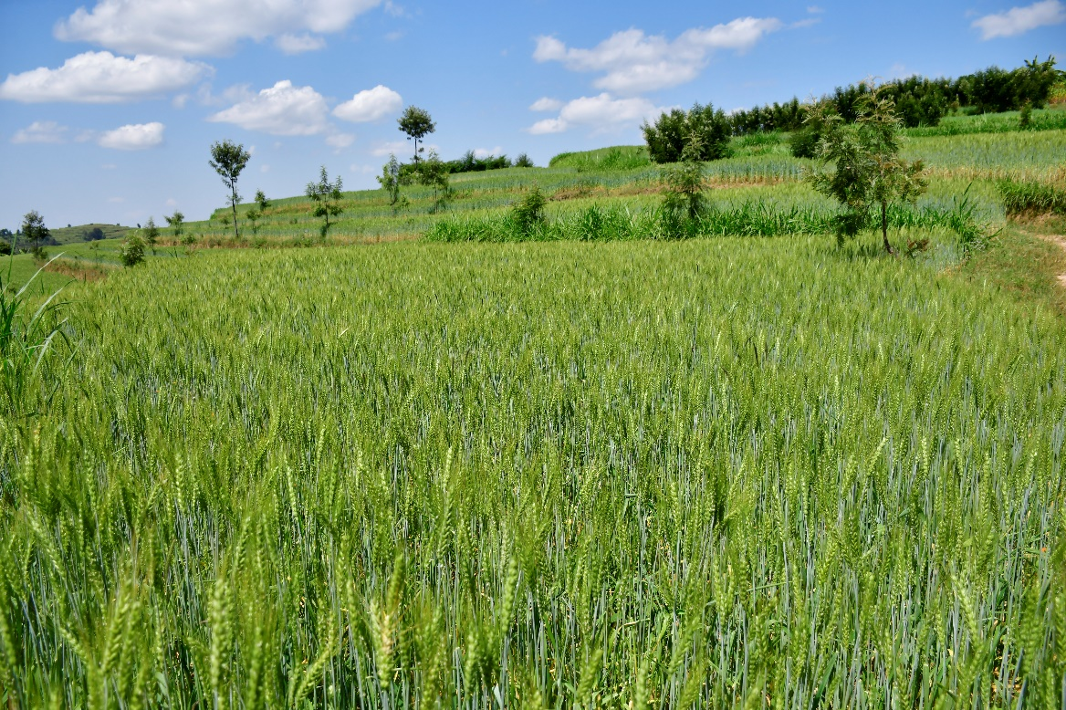
AKARERE KA NYAMAGABE
TUMENYE AKARERE KA NYAMAGABE

Slide 2
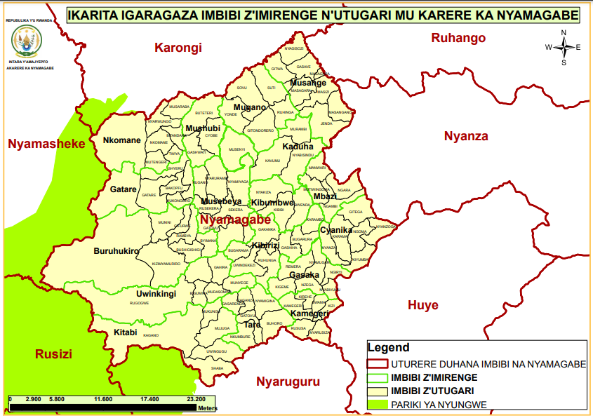
INTANGIRIRO
IMIRENGE | 17
UTUGARI | 92
IMIDUGUDU | 536
AMASIBO | 3794
UBUSO KM ² | :1090
UBUCUCIKE | 313
ABATURAGE | 374,098
ABAGORE | 190790
ABAGABO | 183380
INGO ZOSE | 90198
Ubwiyongere bw’Abaturage | 2%

Slide 3
 | UMUBARE W’UTUGARI | UMUBARE W’IMIDUGUDU | UMUBARE W’ABATURAGE | UBUCUCIKE BW’ABATURAGE | INGO | UBUSO km2
Buruhukiro | 6 | 35 | 27622 | 147 | 6997 | 157.0
Cyanika | 6 | 45 | 28816 | 207 | 7169 | 118.6
Gasaka | 6 | 29 | 26867 | 1027 | 5830 | 40.4
Gatare | 5 | 25 | 18423 | 241 | 4603 | 64.2
Kaduha | 5 | 36 | 23916 | 276 | 5829 | 74.7
Kamegeri | 6 | 21 | 15833 | 416 | 3829 | 32.6
Kibirizi | 6 | 33 | 24767 | 436 | 5533 | 49.3
Kibumbwe | 4 | 23 | 14229 | 256 | 3490 | 48.9
Kitabi | 5 | 30 | 29026 | 265 | 6629 | 96.1
Mbazi | 4 | 20 | 13582 | 355 | 3424 | 33.5
Mugano | 6 | 32 | 20499 | 244 | 5085 | 74.4
Musange | 6 | 33 | 20799 | 297 | 5167 | 62.9
Musebeya | 6 | 38 | 21798 | 352 | 5373 | 53.1
Mushubi | 3 | 25 | 15119 | 352 | 3839 | 36.3
Nkomane | 6 | 35 | 18647 | 207 | 4587 | 79.0
Tare | 6 | 41 | 26417 | 511 | 6318 | 44.5
Uwinkingi | 6 | 35 | 27738 | 264 | 6496 | 90.5
Source | Admin | ADmin | Admi | 4 PHC | ADM | 4PHC

Slide 4
ABATURAGE MU BYICIRO BY’UBUDEHE
ICYICIRO | ABATURAGE | INGO
1 | 60270 | 16603
2 | 147233 | 37645
3 | 166229 | 35865
4 | 366 | 85

Slide 5
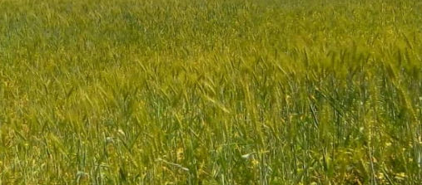
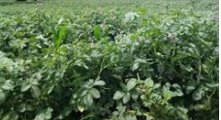
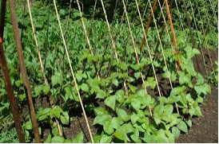
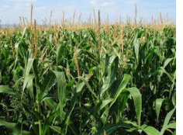
UBUHINZI : 78 % by’Abaturage barengeje imyaka 18 bakora umwuga w’ubuhinzi
EICV3 YAGARAGAJE KO AKARERE KA NYAMAGABE KARI KU MWANYA WA :
2 MU KUGIRA ABAHINZI BAHINGA INGANO (27 % ), IBIRAYI UMWANYA WA 5 (72%),
91 % BAHINGA IBISHYIMBO ,
71 % BAHINGA IBIGORI,
52 % BAHINGA IMYUMBATI
KU BUSO BUHUJE
INGANOZIHINGWA:KURI ha 12,793,
ibirayi kuri ha 18582,
ibishyimbo kuri ha 20,099
imyumbati kuri ha 3458
UBUHUNIKIRO BW’IMYAKA 7, UBWANIKIRO 20 , IBISHANGA BITUNGANYIJE KURI HA 2633.84
Ku mwaka haboneka umusaruro ungana T 25/haw’ibirayi na T3/ha z’ingano na T 3.5/z’ibigori
Ha 190 z’ibishanga ntizitunganyije

Slide 6
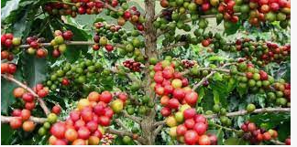
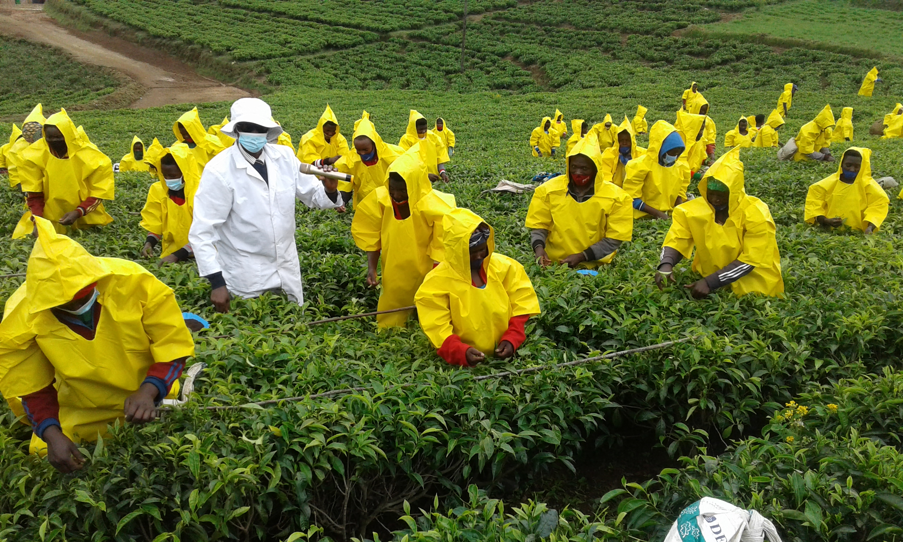
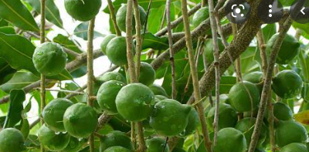
Ibihingwa Ngengabukungu:U
30% y’Ibiti bya kawa birashaje
UBUSO BUTEYEHO KAWA: 1951.4
UMUBARE W’IBITI BYA KAWA: 4,878,500
UMUSARURO WA KAWA ITUNGANYIRIJE MU RUGANDA:MT 612 KU MWAKA
INGANDA ZITUNGANYA KWAWA: 12
IMIRENGE IHINGA KAWA: KAMEGERI,GASAKA,MUSEBEYA,TARE,KIBUMBWE,CYANIKA,MUGANO,MUSHUBI,KIBIRIZI, MBAZI,KADUHA
Umusaruro wa kawa itunganyije uri hagati ya TONI 600 na toni 812/Umwaka
UBUSO BUTEYEHO ICYAYI: HA 2931
UMUSARURO W’ICYAYI CYUMYE : 3720
INGANDA Z’ICYAYI : 2
IMIRENGE IHINGA ICYAYI : KITABI, TARE,UWINKINGI,BURUHUKIRO, GATARE, NKOMANE
MACADAMIYA : ha 51

Slide 7
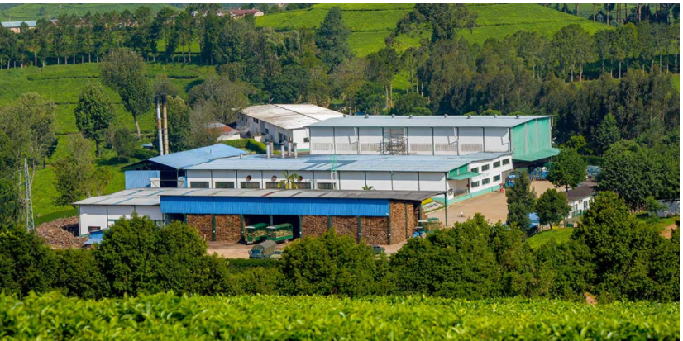
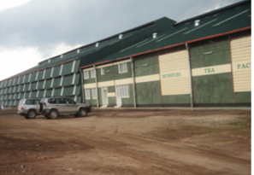
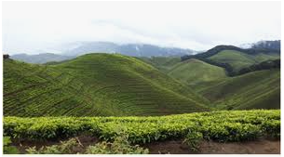
INGANDA ZITUNGA NYA ICYAYI
Ubushobozi: T 3000
Ubushobozi Toni 4500
KITABI
MUSHUBI
Mu mirenge itandukanye hakorerwa amavuta aturuka ku mababi y’Inturusu
Uruganda rwa GITARE MILL Ntirukora

Slide 8
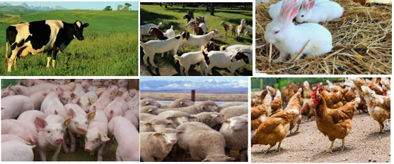


UBWOROZI
77.5 % by’ngo zose ziroroye EICV5
47% boroye inka, 52.6 % boroye ingurube, 53.1 % boroye ihene, 32.5 % boroye inkwavu, 22.3 % boroye inkoko
78 %
74.1 %
IKUSANYIRIZO RY’AMATA | UBUSHOBOZI (L/UMUNSI) | LITIRO BAKIRA KU MUNSI
TARE | 1000 | 470
CYANIKA | 5000 | 210-460

Slide 9
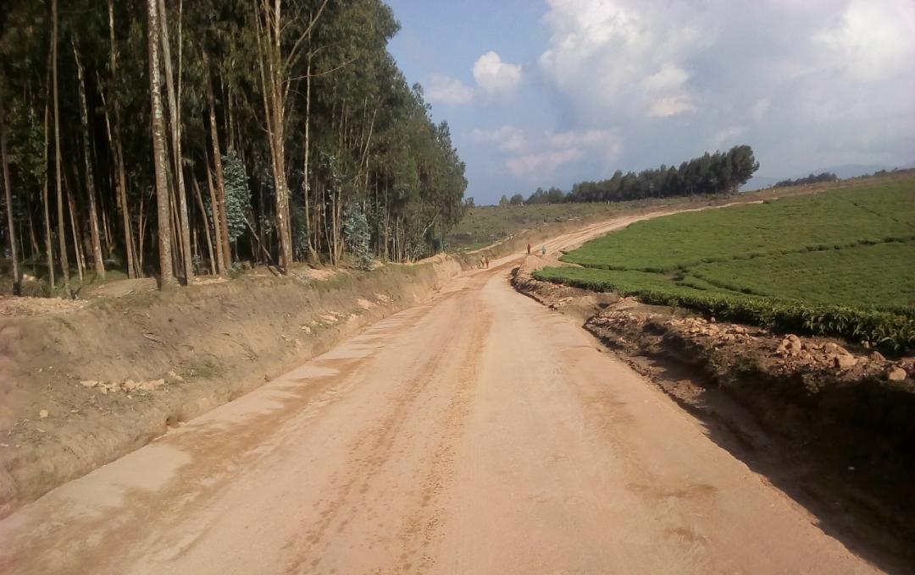
IMIHANDA
UBWOKO | IKICIRO CY’UMUHANDA | UBUREBURE
KABURIMBO | NR CLASS 1 | KM 59
IIBITAKA | NR CLASS1 | KM 113
 | DR CLASS1 | KM 132,884
 | DR CLASS 2 | KM 167

Slide 10
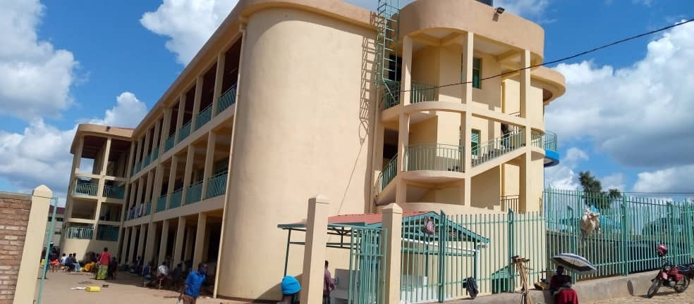
ISHORAMARI
AMASOKO
GASAKA
GASARENDA
MUSEBEYA
MUSHUBI
MIKO
KADUHA
MASIZI
URETSE ISOKO RYA GASAKA NA MUSEBEYA ANDI MASOKO AKENEYE GUSANWA
AMASOKO Y’AMATUNGO
RYARUBONDO
RUGANDA
KADUHA

Slide 11
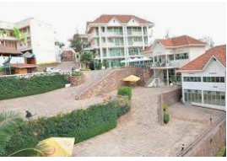
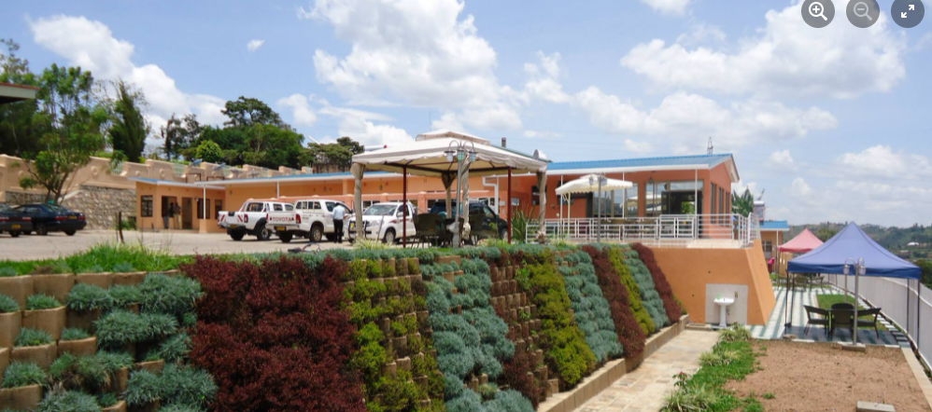
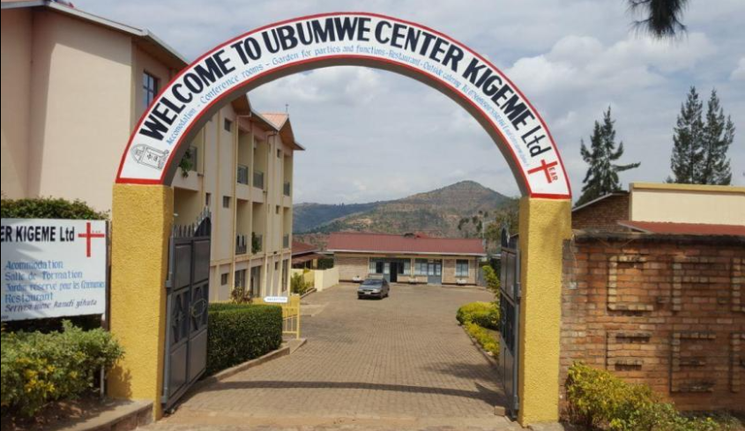
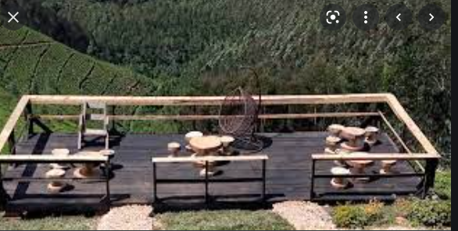
AMAHOTERI
FOREST GARDEN
GOLDEN MONKEY :
Nyungwe Nziza Ecology

Slide 12
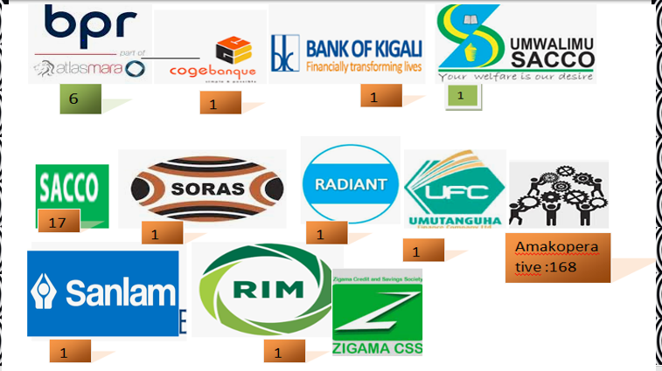
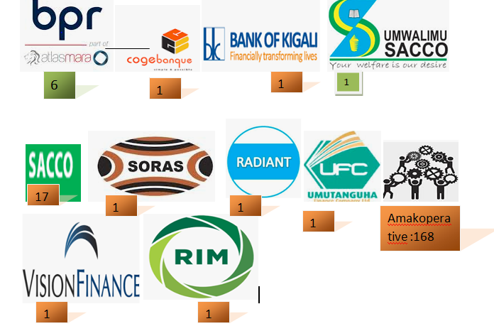






IBIGO BY’IMARI
185
CT NYAMAGABE

Slide 13


ABATURAGE BARI MURI GAHUNDA YA EJOHEZA
24649
603,490,897
321498645

Slide 14
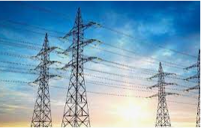
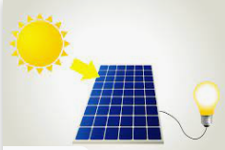
INGO ZIFITE UMURIRO W’AMASHANYARAZI
INGOMERO Z’AMASHANYARAZI
RUKARARA I ( 9.4 MW)
RUKARARA II (2.4 MW)
RUKARARA IV ( 5 MW)
RUKARARAVI (5 MW)

Slide 15
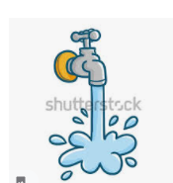
ABATURAGE BAVOMA AMAZI MEZA
84.5%
Isoko itunganyije 67.5 %
Ivomero rusange 12.1 %
Mu rugo 4.1 %

Slide 16
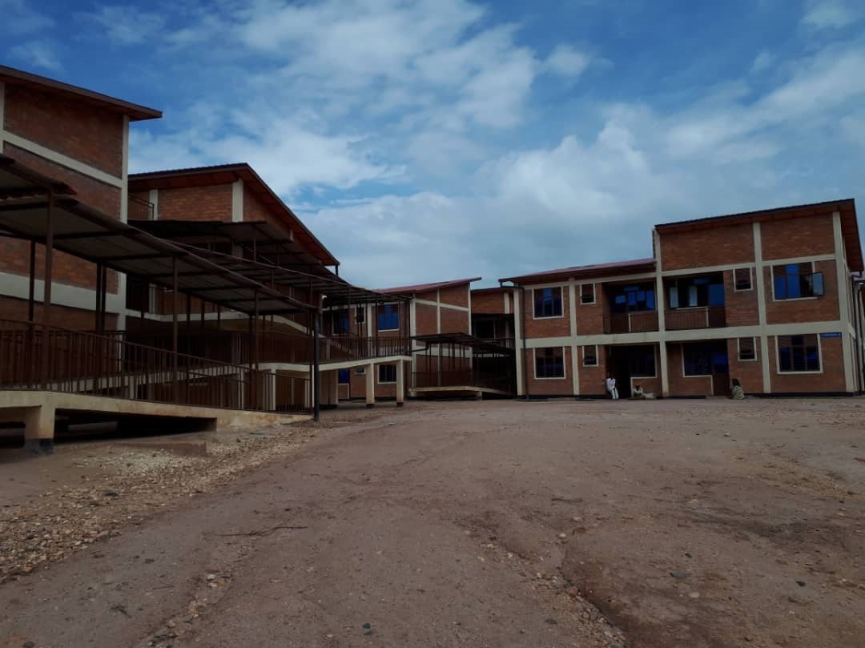
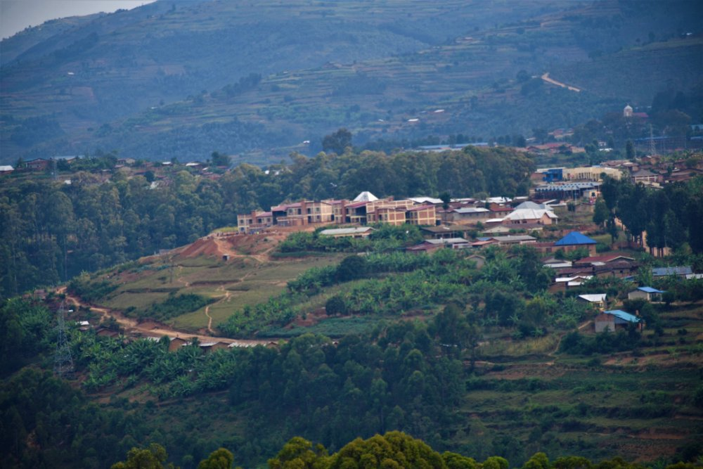
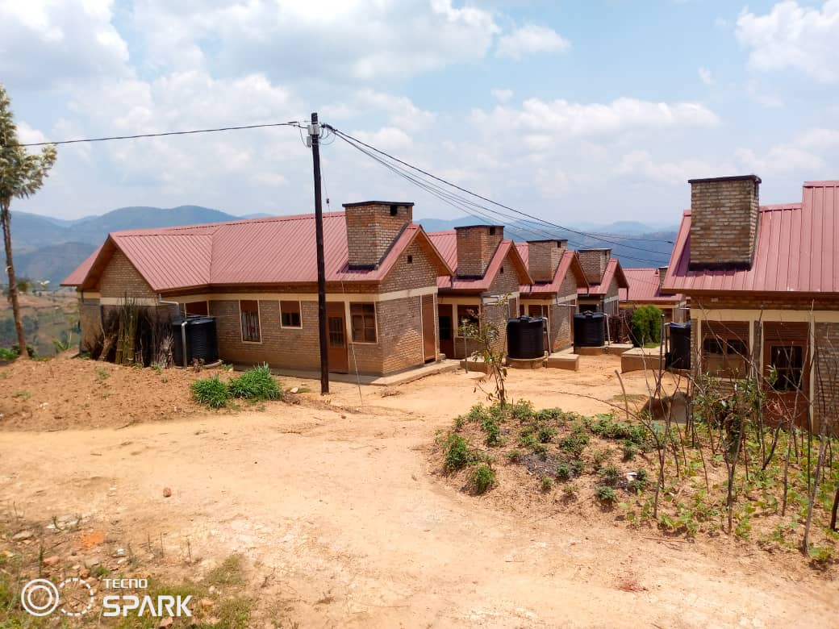
IMIDUGUDU Y’ICYITEGEREREZO
Izina ry’Umudugudu w’icyitegererezo | UMWAKA WUBATSWE | ABAGENERWABIKORA
MUGANO | 2016/2017 | 40
KIBUMBWE | 2017/2018 | 39
TARE | 2018/2019 | 40
KADUHA | 2020/2021 | 32
MUSANGE | 2020/2021 | 20
IGITERANYO |  | 164

Slide 17
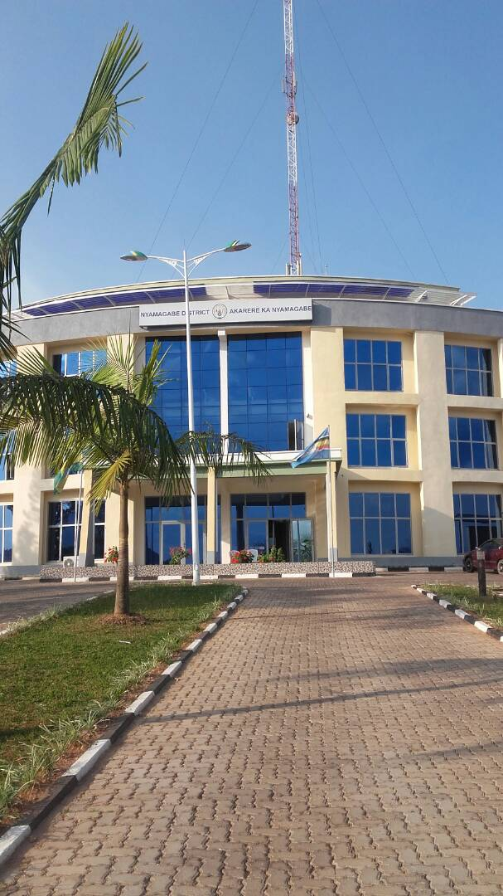
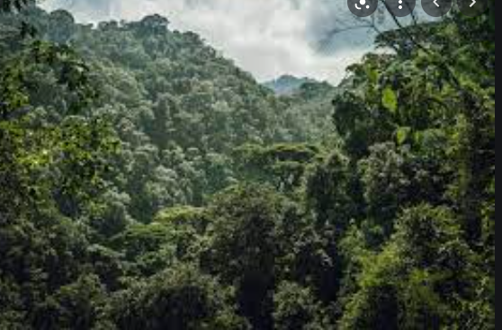
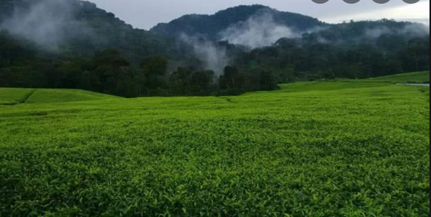
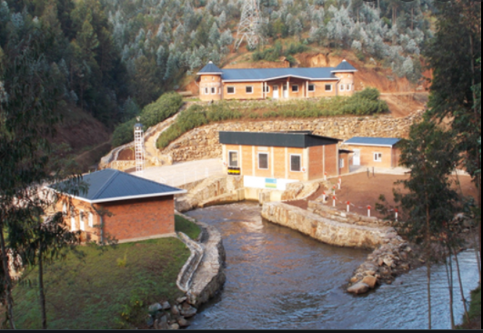
AHANTU NYABURANGA
NYUNGWE
Urugomero rwa Rukarara
Imirima y’ibyayi

Slide 18
UBUZIMA
Ibitaro:2
Ibigonderabuzima 19
Poste de sante : 36
Farumasi y'Akarere 1
farumasi zigenga1
UTUGARI 37/92 Ntidufite ikigo cy’Ubuzima

Slide 19
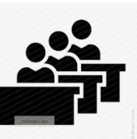

UBUREZI
Ikibazo cy’ibyumba by’amashuri 140 bishaje
Kaminuza: 1
397
IMYUGA : 8
1233 (M721 , F : 512 )
AYISUMBUYE 60
24267 ( M : 10989, F 13278)
Abanza 134
80685 ( M:40570, F :40115)
Incuke :94
7279( M :3515 , F3764)
Ikibazo cy’ibura ry’Abarimu 207

Slide 20
INGENGO Y’IMARI-IMISORO 2011-2021
UBWIYONGERE BW’INGENGO Y’IMARI ( 2011-2021)

Slide 21
URUHARE RW’IMISORO KU NGENGO Y’IMARI
FY | INGENGO Y’IMARI | IMISORO | %
2011-2012 | 9,697,859,291 | 412,387,062 | 4.25
2012-2013 | 10,917,838,617 | 475,642,986 | 4.36
2013-2014 | 11,993,400,068 | 657,490,105 | 5.48
2014-2015 | 12,744,614,452 | 710,070,131 | 5.57
2015-2016 | 14,735,352,935 | 635,816,137 | 4.31
2016/2017 | 14,358,692,742 | 736,952,307 | 4.93
2017/2018 | 14,933,989,202 | 814818494 | 5.5
2018/2019 | 16,976,972,709 | 1,235,693,379 | 7.2
2019/2020 | 22,175,994,417 | 1,132,588,002 | 5
2020/2021 | 26073149603 | 1,090,828,501 | 5
2021/2022 | 27,924,754,434 | 1,380,343,382 ( INTEGO )

Slide 22
Abakozi b’Akarere ka Nyamagabe
Mu burezi haracyabura abarimu 207
Abandi bakozi batari mu myanya ku rwego rw’Akarere ni 9
Ku Mirenge ni 48

Slide 23
% ry’Abagore mu bakozi b’Akarere

Slide 25
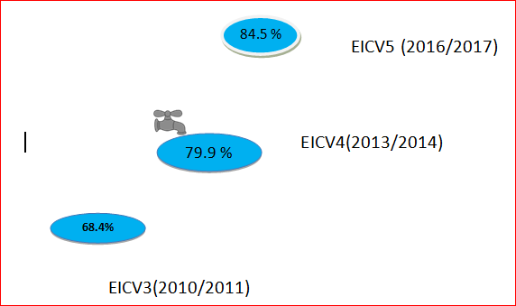
IBIPIMO BY’ITERAMBERE

Slide 26
IBIPIMO BY’ITERAMBERE,….
% ry’Abana bagwingiye bari munsi y’imyaka 5 ( Stunting rate )

Slide 27
UMURAGE NDANGAMUCO 1. IRIBA RYA KUNYU 2. NYUNGWE CULTURAL VILLAGE 3. UBUVUMO BWA KIBUMBWE ( UBWA RUGANZU) 4. IRIBA RYA MUPFU 5. IRIBA RYA NZAVU 6. UMUSOZI WA SUTI 7. URWIBUTSO RWA MURAMBI

Slide 28
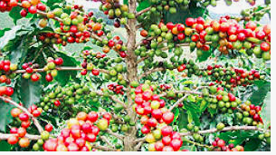
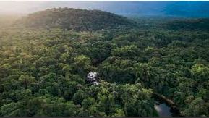
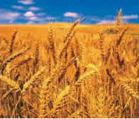
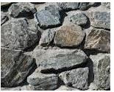
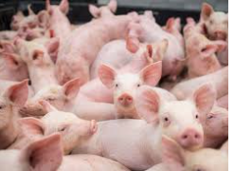
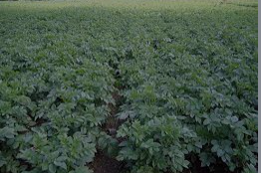
AMAHIRWE AGARAGARA MU KARERE
AMAHIRWE AGARAGARA MU KARERE KA NYAMAGABE

Slide 29
BIG PROJECTS UNDER FOLLOW UP AND IMPLEMENTATION
Name of project | Current status
Construction of NGABWE – RYARUBONDO – KABUGA Waterline which has 23 km by MINEMA | Validation of the inception report
Construction of RYARUBONDO Market by MINEMA | Final validation of the study
Construction of KIGEME Market | Revision of the study
Construction asphalt roads of 10.4 in Gasaka town | Civil works will be restarted by December 2021
Construction of Montana Hotel | Drawings has been done and construction permit has been offered

Slide 30
BIG PROJECTS UNDER FOLLOW UP AND IMPLEMENTATION
Name of project | Current status
Development of Mushishito Marsland( 41.54 Ha) with partnership of UNHCR | Counter verification is being done in order to start activies
Construction of asphalt road from MURAMBI – KIBUMBWE – MANWARI of 47 km as presidential pledge | Costs estimate have been done
Implementing different projects supposed to be allocated at Kaduha – Gitwe corridor | Some of them have started like planting Macadamia , terracing terraces
Construction of a Bridges that connect Mbazi and Musange Sectors | Agreement has been signed by 2 parties (Eng.Brigade & RTDA) out of 3 ((Eng.Brigade , RTDA & RMF)

Slide 31
MURAKOZE

